Slide 1
Office 365 Development

Slide 2
Deep dive into building standalone AngularJS web applications with Office UI Fabric for Office 365

Slide 3

Agenda
Working with Office UI Fabric
Introduction to AngularJS
Modules, Directive and Data Binding
Routes, Views and Controllers
Creating Custom Services in Angular Apps

Slide 4
Developer vision
USERS
DATA
HTML

Slide 5
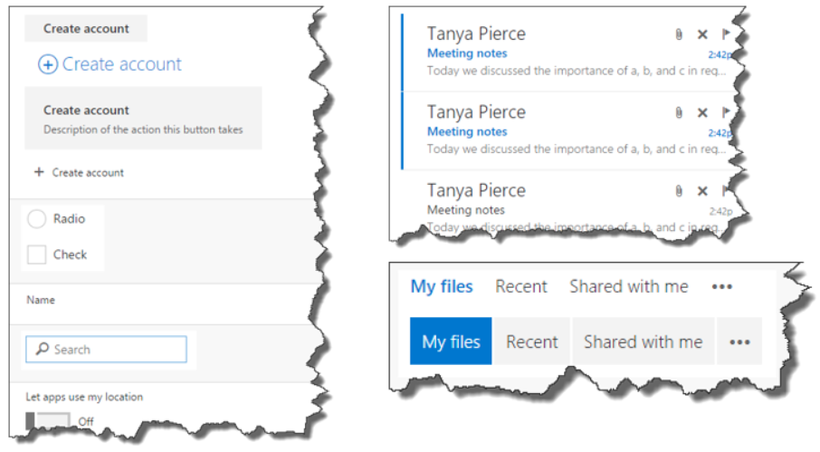
What is Office UI Fabric?
Responsive, mobile-first, front-end framework for developers
Designed to make it simple to quickly create web experiences using the Office Design Language
Designed to work across Office Clients where Office Add-ins are supported
Apply simple CSS styles to make your web applications look and feel like the rest of Office
Styling takes into account typography, color, icons, animations, responsive grid layouts and localization
Reusable components such as input, layout, navigation and content (persona card, list item and table views)

Slide 6
Getting Started
Office UI Fabric GitHub Repository
https://github.com/OfficeDev/Office-UI-Fabric
Design guidelines for Office Add-ins
https://msdn.microsoft.com/EN-US/library/mt484317.aspx
Office 365 JavaScript controls
https://msdn.microsoft.com/en-us/office/office365/howto/javascript-controls
Use Office UI Fabric in Office Add-ins
https://msdn.microsoft.com/EN-US/library/office/mt450443.aspx

Slide 7
demo
Creating a User Interface using Office UI Fabric

Slide 8
Introduction to AngularJS

Slide 9

Introducing AngularJS
Description
Single-Page Application (SPA) Framework
Implements Model-View-Controller (MVC) Pattern
Why Angular
True framework instead of patchwork of libraries
Strong separation of concerns

Slide 10
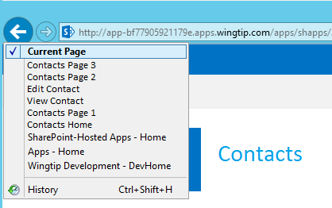
Single-Page Applications
App has one page
Different views are loaded dynamically
Routes are used to simulate pages
History list reflects route navigation
Id
First Name
Last Name
Id
1
First Name
Scot
Contacts.html
Last Name
Hillier

Slide 11
Angular JS Features
Modules
A container for functionality like controllers
Directives
Shared declarative functionality
Data Binding
Declarative binding to HTML elements
Controllers and Views
Maps URIs to dynamic views
Custom Services
Shared programmatic functionality

Slide 12
Angular Framework
Module
Routes
View
$scope
Controller
Directives
Factory

Slide 13
Other Options for Accessing Angular JS
Official Site
http://angularjs.org/
CDN
https://ajax.googleapis.com/ajax/libs/angularjs/1.0.1/angular.min.js

Slide 14
demo
Using AngularJS in a Sharepoint-hosted Add-in Project

Slide 15
Modules, Directive and Data Binding

Slide 16
Directives
Utilizes HTML5 custom data attributes
Spec allows for the addition of custom attributes starting with data-
Angular uses directives for declarative programming
Angular directives start with “ng-”
data-ng-app, initializes the app
data-ng-controller, invokes a controller
data-ng-click, handles click event

Slide 17
Key Directives
data-ng-app: initialize the Angular app
data-ng-controller: designate controller scope
data-ng-repeat: for-each loop
data-ng-cloak: prevents displaying element during app initialization
data-ng-hide: shows or hides an HTML element
data-ng-href: creates Angular-compliant anchor tags
data-ng-src: creates Angular-compliant img tags
data-ng-click: handles click event

Slide 18
Using Angular Directives
Initializes the app. Can be anonymous or named.
<!DOCTYPE html>
<html data-ng-app>
<head></head>
<body>
<input type="text" data-ng-model="displayName"/>
<div data-ng-click="update" ng-controller="myCtrl">
</div>
</body>
</html>
Creates a property on the ViewModel
References a controller named “myCtrl”, which creates a new ViewModel.
References a controller method to call on a click event

Slide 19
Data Binding
Binds ViewModels to HTML elements
Uses {{…}} syntax
References a property of a ViewModel
Supports two-way binding
<div ng-app="App">
<div>
<input type="text" data-ng-model="firstName"/>
<div>{{firstName}}</div>
</div>
</div>
Display whatever the user types

Slide 20
Filters
Perform common operations on data bound elements
Takes the form of {{ expression | filter }}
<div ng-app="App">
<div>
<input type="text" data-ng-model="firstName"/>
<div>{{firstName | uppercase}}</div>
</div>
</div>
Display data in all caps

Slide 21
Key Filters
Format
currency
date
number
Displaying data sets
orderBy
limitTo
String manipulation
uppercase
lowercase

Slide 22
Routes, Views and Controllers

Slide 23
Model-View-Controller with Angular
Model
Special variable $scope
Analogous to MVC5 “ViewBag”
Views
HTML pages utilizing data binding
Controllers
JavaScript modules
View
Controller
Data
$scope
Model

Slide 24
Understanding $scope
$scope is the ViewModel in AngularJS
Allows for the attachment of properties
Controller populates the $scope
Transferred from the Controller to the View
View binds to the properties

Slide 25
Understanding Modules
A container for the components of the app
Declare a new module when app starts
Add a related directive to the HTML page
New components like controllers and services can be added dynamically to the module
//module
var myapp = angular.module("MyApp", []);
<!-- html -->
<div data-ng-app = "MyApp">
Reference dependent modules here

Slide 26
Understanding Controllers
Controllers are JavaScript functions
Controllers set properties on the $scope
Created using a Module
Angular “injects” the $scope into the Controller
//controller
myapp.controller("welcomeCtrl", ["$scope",
function welcomeCtrl($scope) {
//ViewModel
$scope.welcomeMessage = "Hi";
}
]);
<!-- html -->
<div data-ng-controller="welcomeCtrl">{{welcomeMessage}}</div>

Slide 27
Routes
Used for loading different partial views in a SPA
Angular manages history automatically
HTML chunks make up the partial views
Views can be embedded as a script template in the SPA
Views can also be kept as separate partial HTML pages
Defining Routes
Add Angular JS Route NuGet Package
Reference the ngRoute Module
Define routes using the $routeProvider

Slide 28
Defining Routes
Route module
//module
Wingtip.App = angular.module("App", ["ngRoute"]);
Wingtip.App.config(["$routeProvider",
function ($routeProvider) {
$routeProvider.
when("/welcome", {
templateUrl: "partials/welcome.html",
controller: "welcomeCtrl"
}).
otherwise({
redirectTo: "/"
});
}]
);
<!–- HTML -->
<div data-ng-view> </div>
Partial page
Rendered here

Slide 29
Creating Custom Services in Angular Apps

Slide 30
Understanding Services
Allows common functionality to be factored out into a single component and used by many Controllers
Defined by the Module in the same way Controllers are defined
The new Factory is injected into Controllers
Wingtip.App.factory("welcomeService", function ($rootScope) {
var welcomeService = {};
welcomeService.greet = function () {
alert("Hi!");
};
return welcomeService;
});
Wingtip.App.controller("myCtrl", ["$scope", "welcomeService",
function contactsCtrl($scope, welcomeService) {
welcomeService.greet();
}]
);

Slide 31
Summary
Working with Office UI Fabric
Introduction to AngularJS
Modules, Directive and Data Binding
Routes, Views and Controllers
Creating Custom Services in Angular Apps

Slide 32
Further reading…
Getting Started with APIs
Angular Code Samples
Angular Training videos & hands on labs
Microsoft Graph API documentation

Slide 33
Developer Program Launch
1 YEAR FREE
E-mail Newsletters
Free Developer Subscription
Free Training
Free Tools
Webinars
http://dev.office.com/devprogram

Slide 34


Engage
Office 365 Network
https://www.yammer.com/itpronetwork
Twitter
S
S
t
t
a
a
r
r
t
t
@OfficeDev
Stack overflow
[ms-office]
Channel 9 Dev Show
http://aka.ms/O365DevShow
Podcasts http://dev.office.com/podcasts
Snack Demos
http://aka.ms/o365DevSnackDemos
UserVoice
http://officespdev.uservoice.com/

